Slide 1
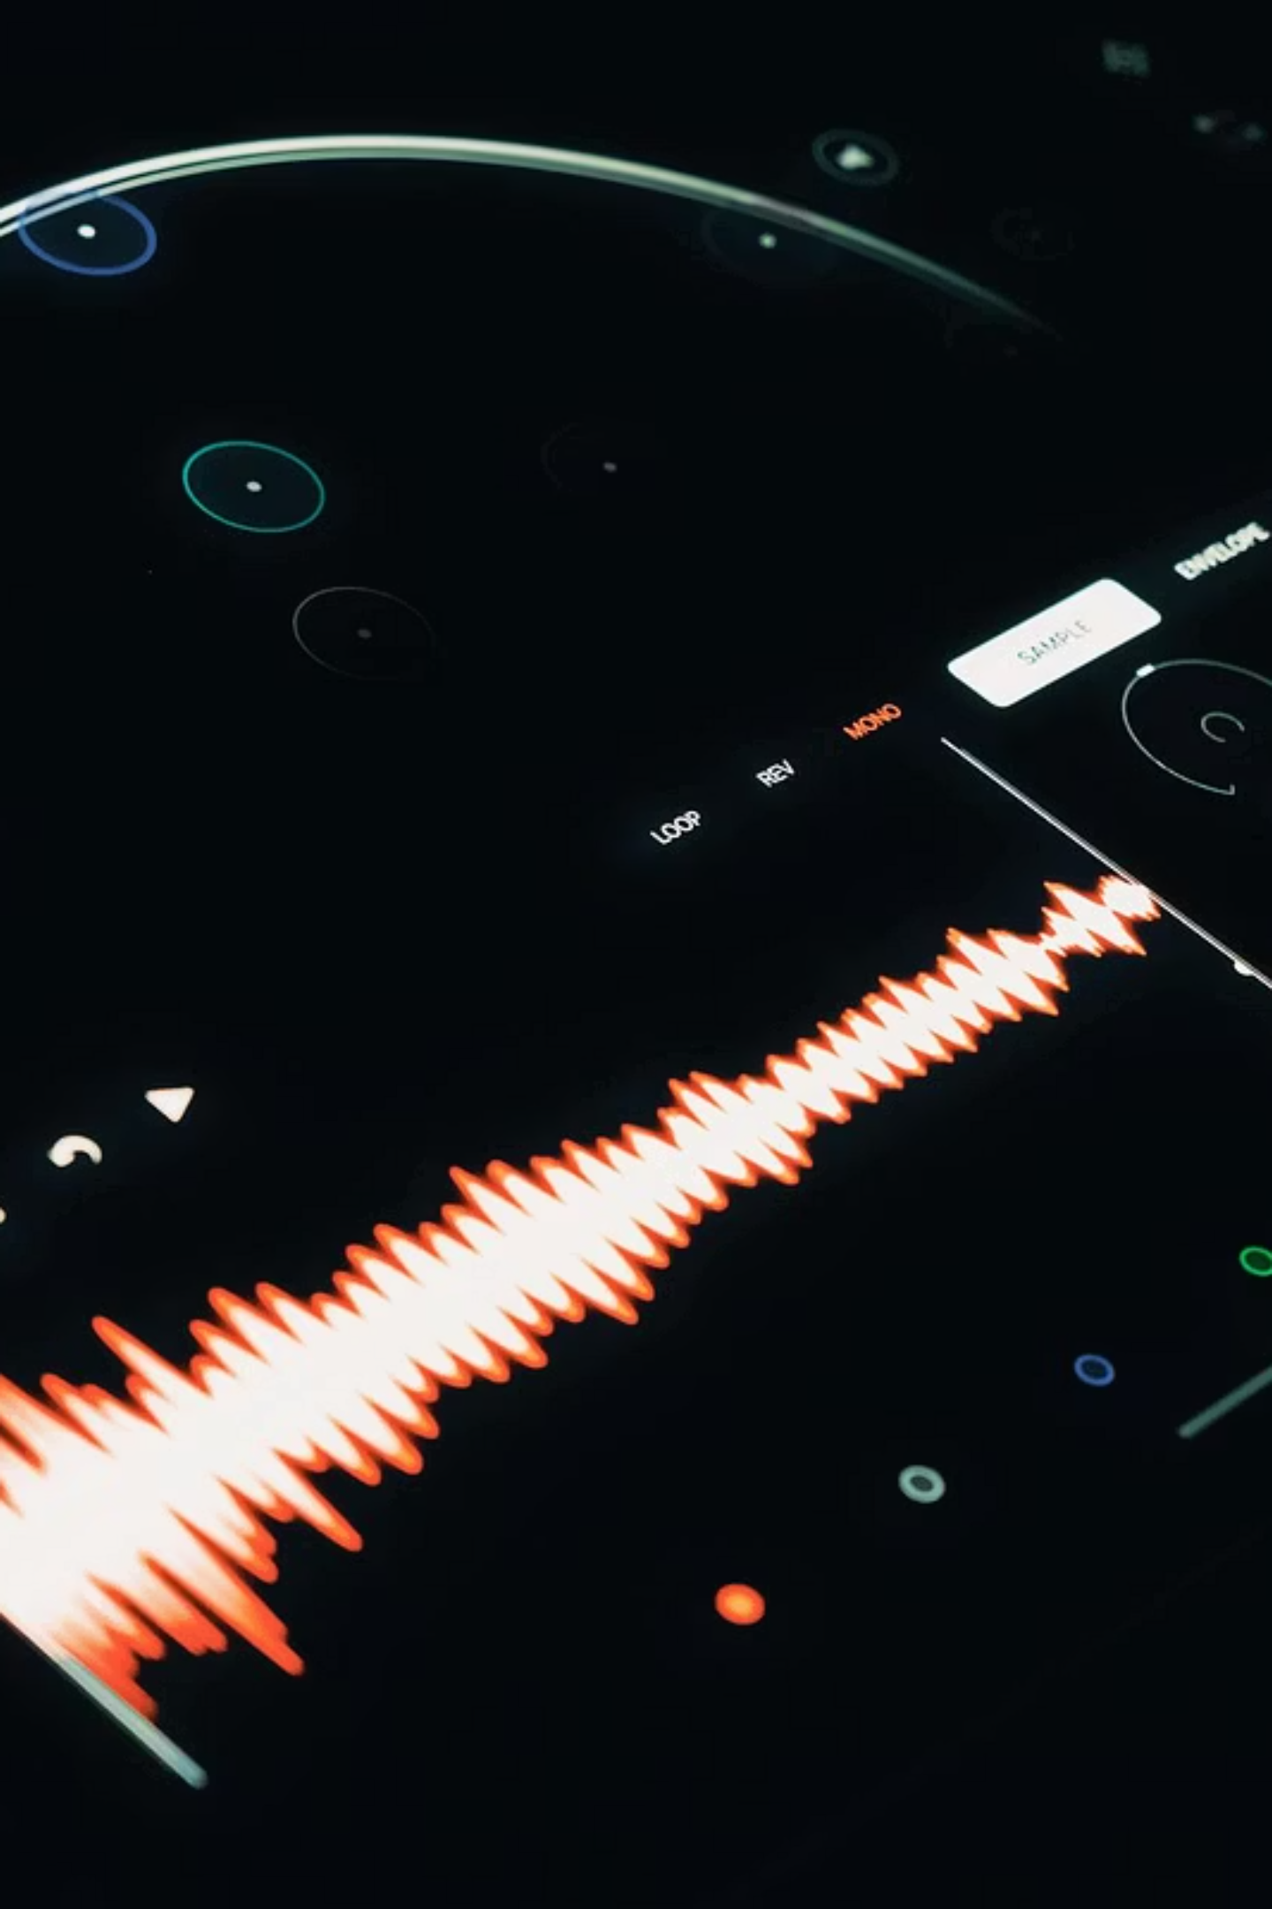
MSC DATA SCIENCE · GROUP 6 · UWE BRISTOL · 2026-2027
Offline Voice-Driven Appointment Booking Using Fine-Tuned Small Language Models
Can a 3B-parameter model, fine-tuned on 600 domain samples, achieve acceptable accuracy for structured appointment management with no cloud connection required?
1 / 11

Slide 2
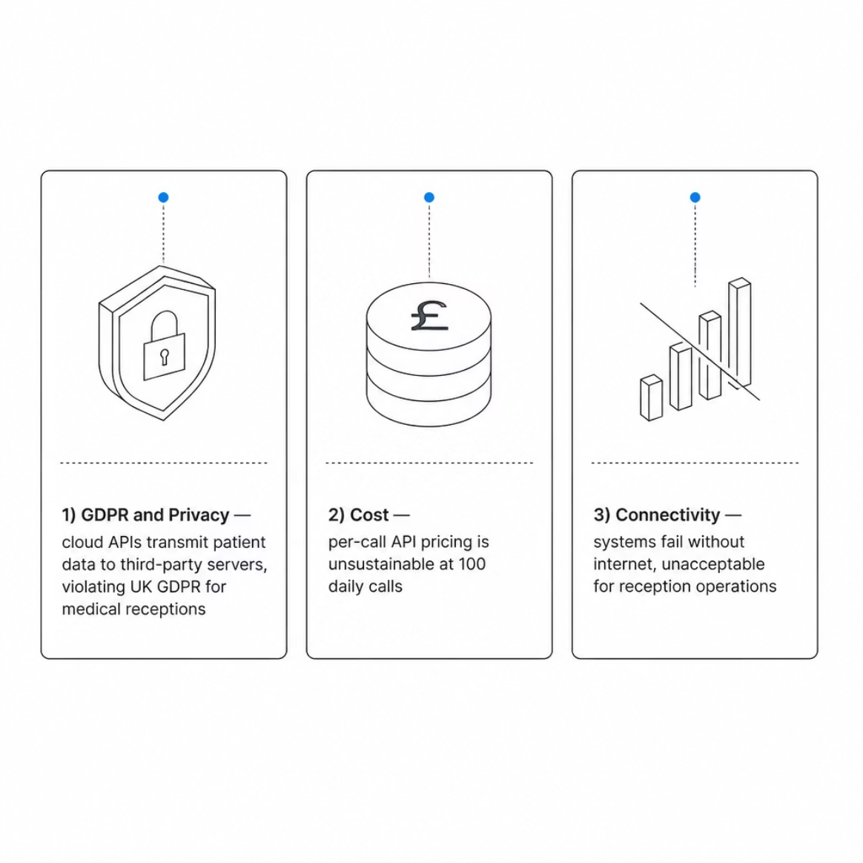
PHASE 0: PROBLEM DEFINITION
Why Existing Voice Booking Systems Fail SMEs
Motivation for the system
These constraints create the need for an offline voice booking system that handles structured appointments reliably, affordably, and without sending sensitive data to the cloud.
Research Question
Can a small fine-tuned model replace cloud NLU for structured voice booking with no internet required?
Research Contribution
Offline pipeline running entirely on CPU
Fine-tuning a 3B model with 600 synthetic samples for structured JSON actions
Small models achieve near-perfect structured accuracy with domain-specific training
Ethical and Legal Notes
No personal data leaves the device
Synthetic training data avoids privacy risks
No storage of caller audio or metadata
Key References
Kraus et al. (2022) "Artificial intelligence in small and medium enterprises" - J. Small Bus. Manage.
Nguyen et al. (2022) "Understanding SME adoption of AI: A TOE framework" - Technol. Forecast. Soc. Change
2 / 11

Slide 3
From Rule-Based IVR to Fine-Tuned Language Models
2012
Deep Speech - Mozilla's open-source neural speech recognition, moving away from speaker-dependent systems.
2015
LibriSpeech benchmark (Panayotov et al.) - Standardized evaluation dataset enabling reproducible speech recognition research.
2021
LoRA (Hu et al.) - Parameter-efficient fine-tuning method enabling adaptation of large models with minimal compute.
2022
Whisper, OpenAI (Radford et al.) - Robust, multilingual speech recognition trained on 680k hours of web audio.
2023
QLoRA (Dettmers et al.) - Llama 3.2 3B, Meta - Quantized LoRA enabling fine-tuning of 3B models on consumer GPUs.
2024
Faster-Whisper, SYSTRAN - Optimized Whisper inference for CPU-only deployment.
2026
This project - Offline voice-driven appointment booking using fine-tuned 3B models on commodity hardware.
From neural speech recognition (2012) to fine-tuned small models (2026), the field has shifted toward domain-adaptive models that can run offline.
Key References
Radford et al. (2023) "Robust speech recognition via large-scale weak supervision" - ICML [Whisper].
Hu et al. (2022) "LoRA: Low-rank adaptation of large language models" - ICLR.
Dettmers et al. (2023) "QLoRA: Efficient finetuning of quantized LLMs" - NeurIPS
3 / 11

Slide 4
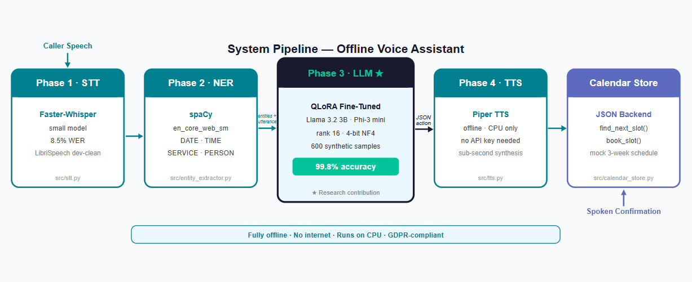
Focus: Phase 3 (Fine-Tuned LLM). Phase 4 (TTS) and backend calendar cache are also implemented.
The System Pipeline: 4 Phases
Every phase runs on CPU with no cloud dependency. The pipeline is GDPR-compliant and deployable on standard hardware. Total latency is approximately 4 seconds.
Key References
Radford et al. (2023) "Robust speech recognition via large-scale weak supervision" - ICML [Whisper/Faster-Whisper].
Dettmers et al. (2023) "QLoRA: Efficient finetuning of quantized LLMs" - NeurIPS
4 / 11

Slide 5
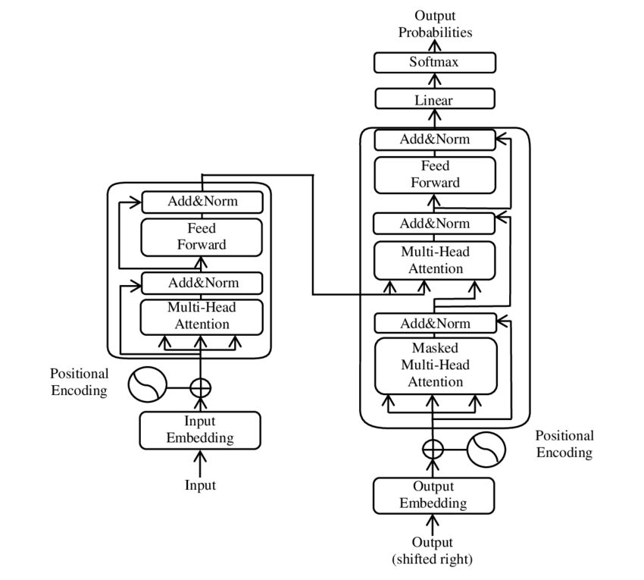

PHASE 1: SPEECH RECOGNITION
Speech Recognition: Benchmark Results
Faster-Whisper on CPU
Faster-Whisper runs Whisper’s encoder-decoder on-device. Audio is converted to a log-mel spectrogram, encoded through stacked attention layers (diagram), and decoded to text. Two model sizes were benchmarked: tiny (17.3% WER, 0.53 s/utterance) and small (8.5% WER, 4.5 s/utterance).
Key trade-off: Small at 4.5 s/utterance exceeds the ~1s perception threshold for live calls. Tiny at 0.53 s fits. The 8.8 pp WER gap is partly offset by downstream NER and LLM context inference.
Real telephony WER is typically 15-25% due to noise and accents. Downstream NER and LLM steps absorb many word-level errors through contextual inference.
Key References
Radford et al. (2023) "Robust speech recognition via large-scale weak supervision" - ICML.
Yu et al. (2021) "Real-time inference in production ML systems" - VLDB (latency threshold justification)
Vaswani et al. (2017) "Attention is all you need" - NeurIPS. [Transformer architecture used by Whisper]
5 / 11

Slide 6
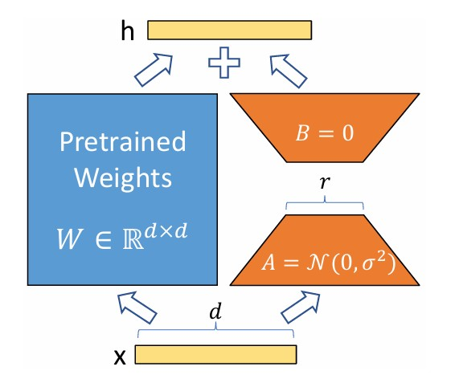
PHASE 3: FINE-TUNED LLM - EVALUATION DESIGN
Fine-Tuning and Evaluation Design
QLoRA Method
QLoRA quantises the backbone to 4-bit NF4 (2 GB), then trains rank-16 LoRA adapters. Settings: rank=16, lora_alpha=32.
Evaluation Design
480 training samples, 60 validation samples per model. Separate 480-sample evaluation set: 120 samples per condition (Phi-3 vanilla, Phi-3 fine-tuned, Llama 3.2 vanilla, Llama 3.2 fine-tuned).
Training time: 60-70 minutes per model on Kaggle T4 GPU (free tier). Data: 600 synthetic samples (Claude Opus-4, Anthropic 2024). Primary metric: action accuracy.
Key References
Hu et al. (2022) "LoRA: Low-rank adaptation of large language models" - ICLR.
Dettmers et al. (2023) "QLoRA: Efficient finetuning of quantized LLMs" - NeurIPS.
Microsoft Research (2024) "Phi-3 technical report" - arXiv:2404.14219.
Meta AI (2024) "Llama 3.2: Open Foundation and Gradient Models"
6 / 11

Slide 7
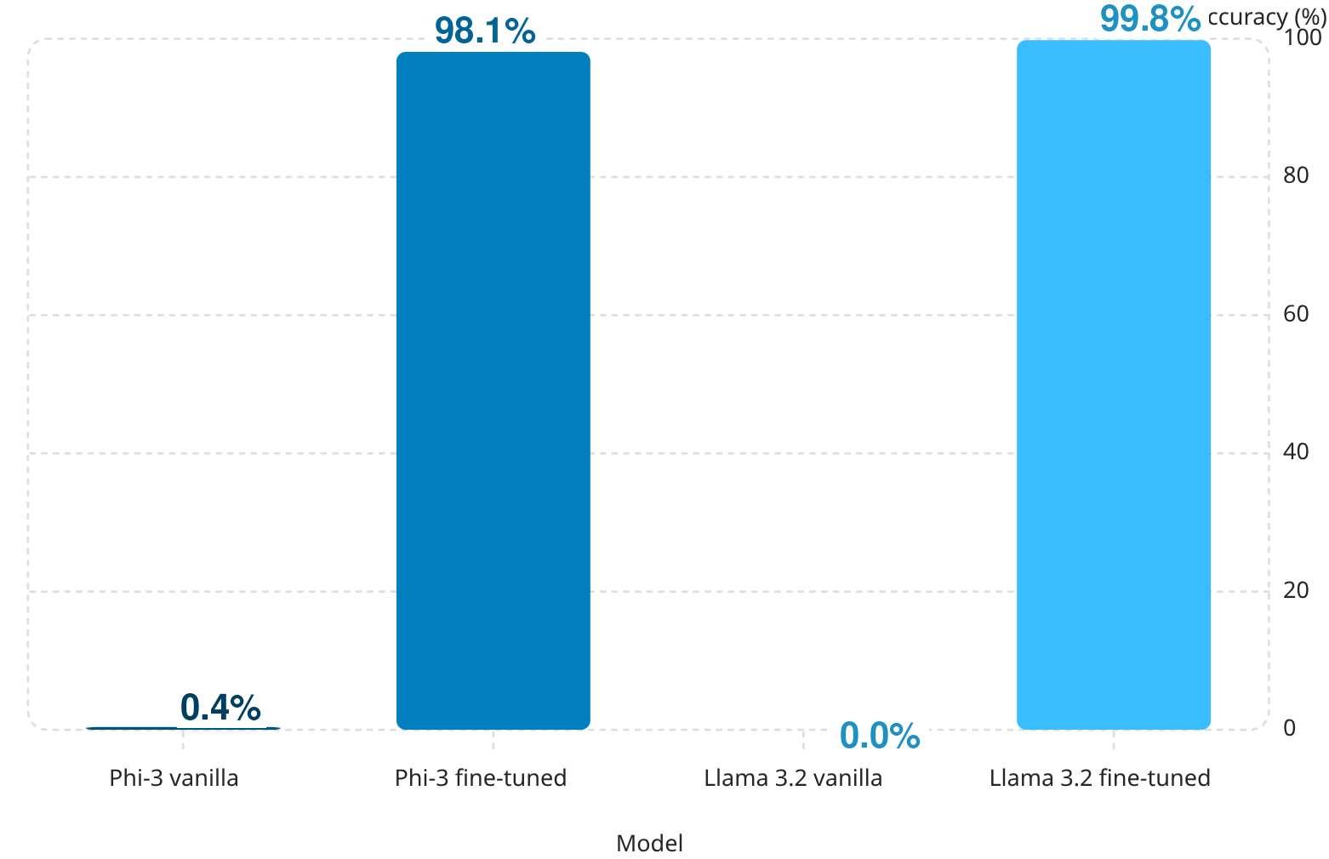

PHASE 3
Fine-Tuning Transforms Failure into Near-Perfect Accuracy
H1 Confirmed
Fine-tuned models exceed the 90% accuracy threshold.
H2 Confirmed
Vanilla models fail completely (0.0% to 0.4%).
H3 Confirmed
Vanilla models respond in natural language instead of JSON. Fine-tuning on 600 examples teaches the model to produce valid structured output every time. Task-specific training, not model size, determines suitability for structured NLU.
Llama 3.2 fine-tuned outperforms Phi-3 fine-tuned.
Key References
Dettmers et al. (2023) "QLoRA: Efficient finetuning of quantized LLMs" - NeurIPS.
Hu et al. (2022) "LoRA: Low-rank adaptation of large language models" - ICLR
7 / 11

Slide 8
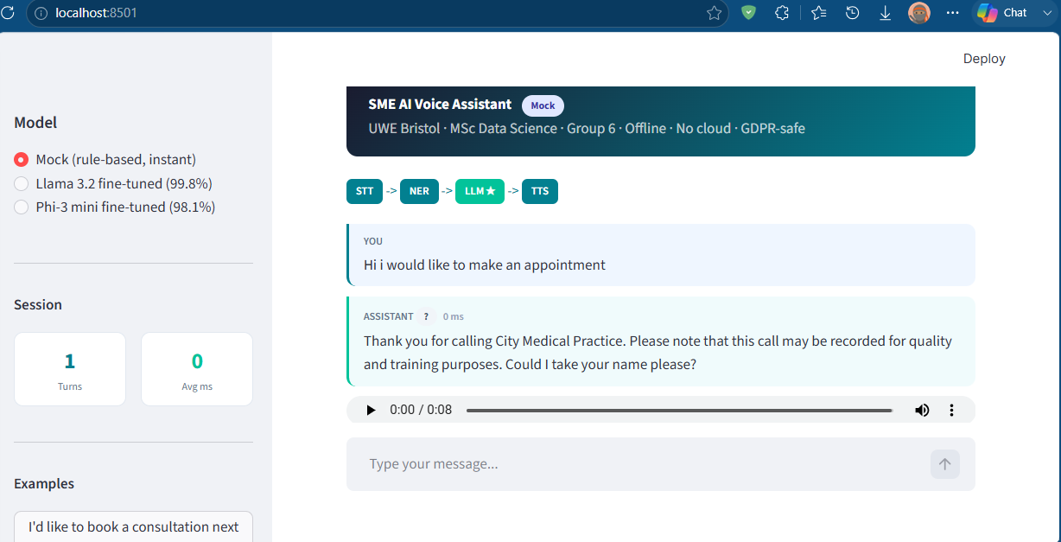


PHASE 4: TEXT-TO-SPEECH & INTEGRATION
System in Action
Conversation Transcript
The system captures the name, checks the calendar, suggests a slot, confirms the booking, and plays a spoken TTS response - all on CPU, no cloud.
Video demo: [link to demo]
User: "Book me in Monday"
Assistant: "Next available slot is Monday at 9:00 AM. Does that work?"
User: "Yes"
Assistant: "Confirmed. Your appointment is booked for Monday 9:00 AM."
Key References
Shen et al. (2021) "Towards End-to-End Speech Recognition with Hierarchical Phoneme and Grapheme Representations" - End-to-end pipeline design.
Zen et al. (2019) "Unified Voice Conversion with Conditional VAE and Adversarial Learning" - TTS synthesis.
8 / 11

Slide 9
LIMITATIONS & FUTURE WORK
Limitations and Future Directions
Limitations
Future Work
STT tested only on clean speech - WER is higher on telephony audio
Faster-Whisper Tiny model was used instead of more advanced model due to hardware limit
Calendar is a mock - no integration with real practice systems
Training data is synthetic
CPU latency is approximately 3.5 seconds
Real telephony integration (SIP/PSTN)
Comparison with GPT-4o on structured output quality
Website develop development (in progress)
Web frontend integration (in progress)
WER and booking metrics dashboard
REST API backend (FastAPI + SQLite) ready for frontend connection
9 / 11

Slide 10
MSC DATA SCIENCE · GROUP 6 · UWE BRISTOL · 2026-2027
Team Contributions
Team Member
Contributions
Karan Homayounfar
Pipeline design, fine-tuning, backend API, evaluation
Christopher Dixon
User evaluation with real participants, business case research
Chukwunonye Peter Ekpedo
Web frontend, API integration
Iyenoma Goodnews Osabuohien
System testing and documentation
Theophilus Ugochuku Azizeli
Literature review, frontend development
10 / 11

Slide 11
MSC DATA SCIENCE · GROUP 6 · UWE BRISTOL · 2026-2027
Conclusion
1 · Fine-Tuning Turns Failure into Reliability
2 · 600 Synthetic Samples Are Sufficient
3 · Offline Deployment Is Viable
Vanilla models score 0.0-0.4%. Fine-tuned models score 98.1-99.8%. The improvement is absolute.
Training takes 60-70 minutes on a free Kaggle GPU.
The full pipeline runs on CPU with no cloud dependency, satisfying GDPR constraints.
Small models are not unsuitable for structured tasks. They are undertrained for them. Domain-specific fine-tuning closes the gap.
11 / 11

